Slide 1
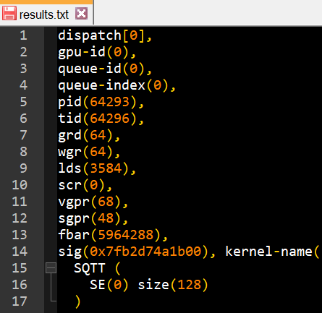
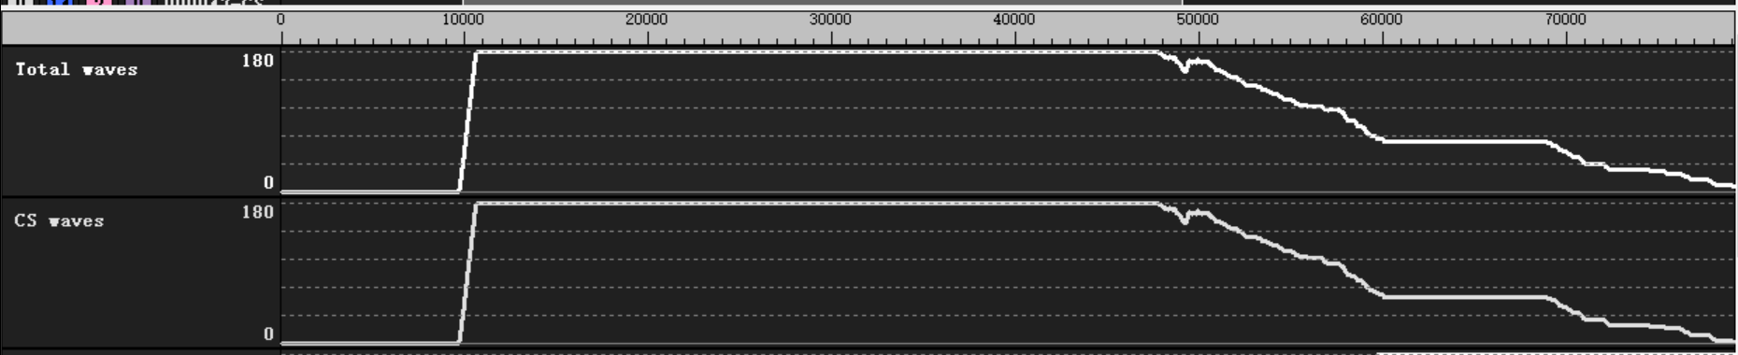
Weekly
Delivery item 1：
analysis with radix16 vgpr consumption for size 4096
JIRA：Analyze and improve butterfly performance
Dump info :
rocprof -i input.txt -d ./ ./rocfft_test
rpl_data_201112_014912_64111/input1_results_201112_014912/results.txt
1d c2c 4096len kernel:
fft_fwd_op_len4096
group size = 256 (4 wave)
lds = 4096DW (4 group per CU at most, 4 wave per SIMD)
VGPR = 68 (3 wave per SIMD, 3 group per CU at most)
If launch 4 group per CU
Batch = 4 * CU_NUM
Only 3 group inflight
12 wave inflight per CU

Slide 2
Weekly
Delivery item 1：
Analysis vgpr usage for all size in the JIRA
LDS: 16K DW per CU
VGPR: 16K DW per SIMD, 64 thread per WAVE, 256 VGPR per thread
length | radix | VGPR | LDS(DW) | grp_size/ Wave | grp_lmt_lds (CU) | wv_lmt_vgpr (SIMD) | gpr_lmt_vgpr (CU) | Best Vgpr usage / (reduce) / group num
112 | 7 | 68 | 896 | 64 / 1 | 18 | 3 | 12 | 51 (17) / 20
512 | 8 | 40 | 512 | 64 / 1 | 32 | 6 | 24 | 32 (8) / 32
2187 | 3 | 48 | 2187 | 243 / 4 | 7 | 5 | 5 | 36 (12) / 7
3125 | 5 | 120 | 3125 | 128 / 2 | 5 | 2 | 4 | 84 (35) / 6
4096 | 16 | 68 | 4096 | 256 / 4 | 4 | 3 | 3 | 64 (4) / 4

Slide 3
Weekly
reason
Why compiler use 68 vgprs
Input load and result write has the same address calculation in the beginning and end of the kernel
addr_in = inOffset + ( 0 + me*1 + 0 + instr_step ) * stride_in; x16
addr_out = outOffset + ( 0 + me*1 + 0 + instr_step ) * stride_out; x16
Compiler will reserve some vgpr (about 16 vgprs) to hold the template variable, and allocate new vgprs to do global load
temp_var = ( 0 + me*1 + 0 + instr_step)

Slide 4
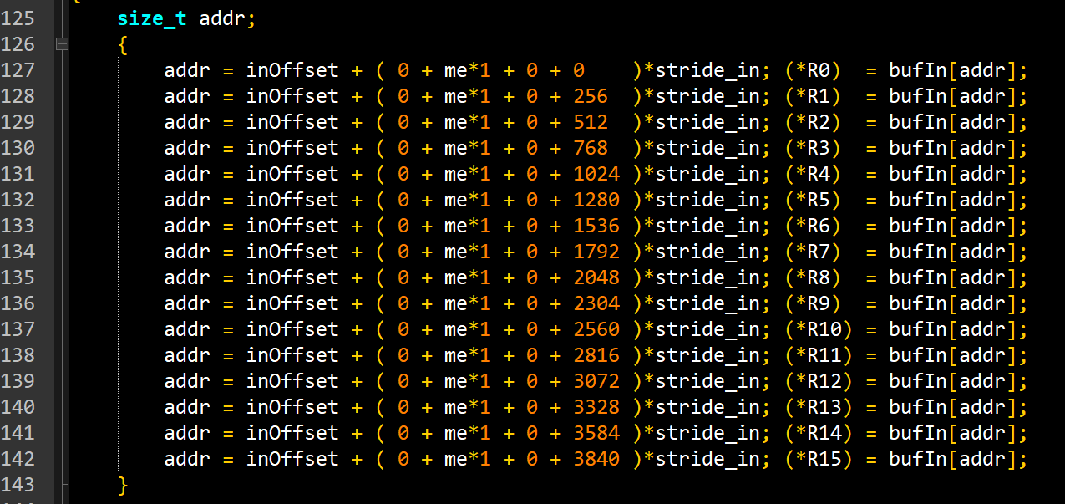
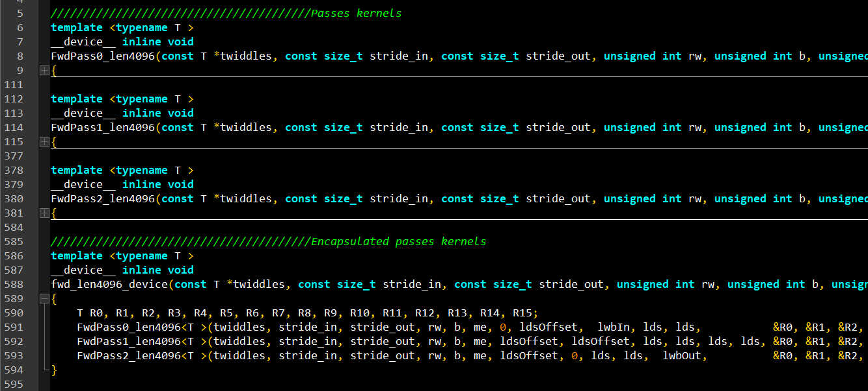
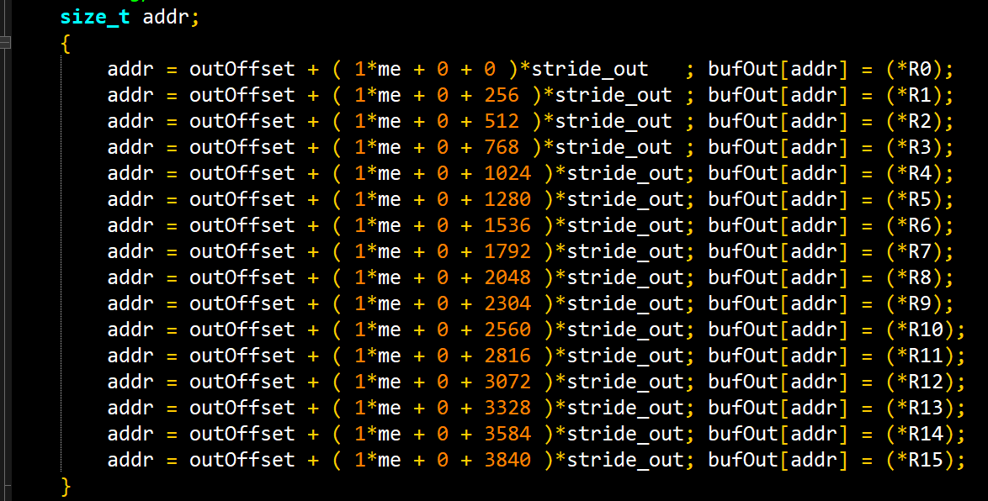
Weekly
reason
Notes:
__constant

Slide 5
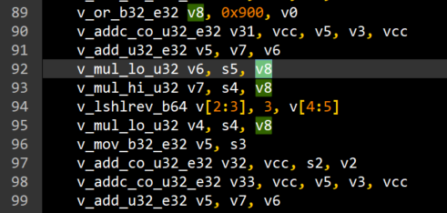
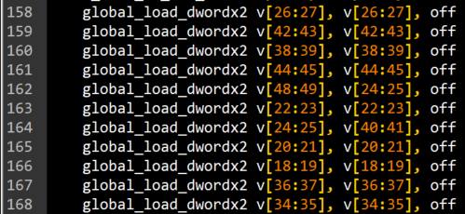
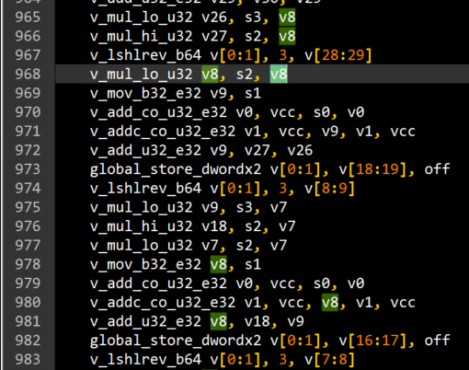
Weekly
reason
Example V8
V8 (= me * 1 ) are allocate in the beginning of the kernel
V8 = 0 + me * 1 + 0;
S[4:5] = stride_in
V[6:7] = (0 + me*1 + 0) * stride_in
S[2:3] = InBuff
V[32:33] = global_load_addr
Compiler allocate new vgprs (V16~V49)to do global load
V8 is not used during fft calculation
At the end of the kernel, V8 still holds the value of me*1
Compiler could use V8 to calculate global write address
S[0:1] = OutBuff
S[2:3] = stride_out
V[0:1] = global_store_addr
V[8:9] = (0+me*1+0) * stride_out

Slide 6
Weekly
Solution 1
Solution 1: Cheat compiler
Use different formula to calculate input/output address.
addr_in = inOffset + ( 0 + me*1 + 0 + instr_step) * stride_in;
addr_out = outOffset + ( 0 + me*1 + 0 + (instr_step + 1)) * stride_out – stride_out;
Compiler won’t reserve vgprs for to hold template variable
Compiler will allocate fewer vgpr for global load
Vgprs will be re-used during fft calculation
16 data (32 VGPR)
Twiddle (12 VGPR)
Addressing (8 VGPR)

Slide 7
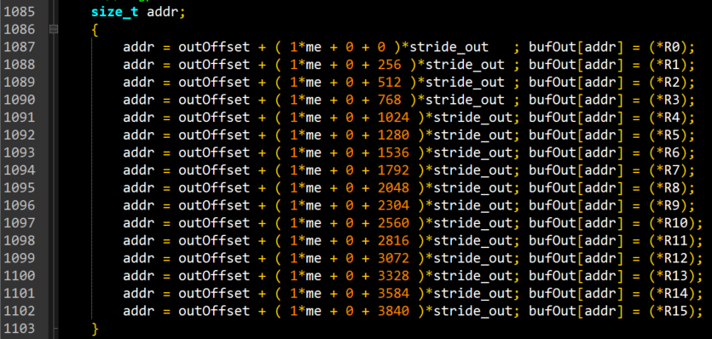
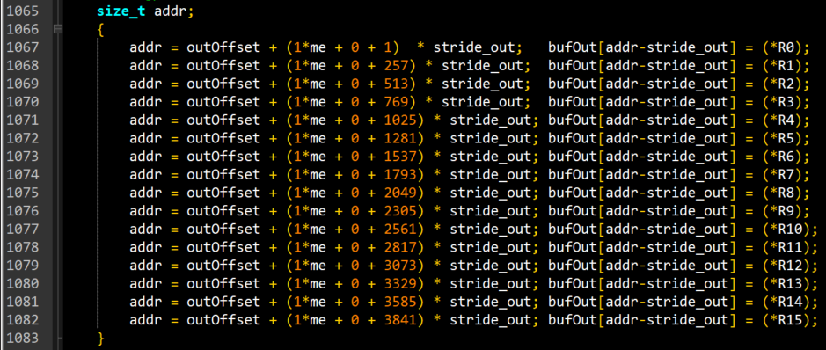
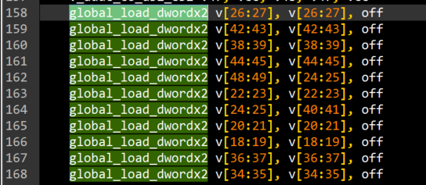
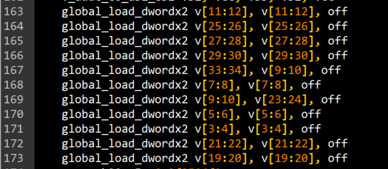
Weekly
Solution 1
Solution 1: Cheat compiler

Slide 8
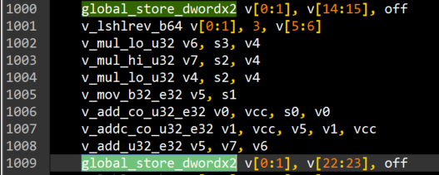
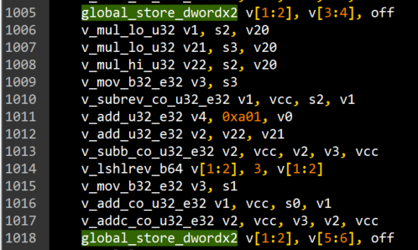
Weekly
Solution 1
Disadvantage
Because template variable need to re-calculate during global write, compiler will generate more instruction for output address.
Increase 4 instructions per address, totally 64 instructions
This will cause perf-drop for small batch size (parallel group less than 4 per CU)

Slide 9
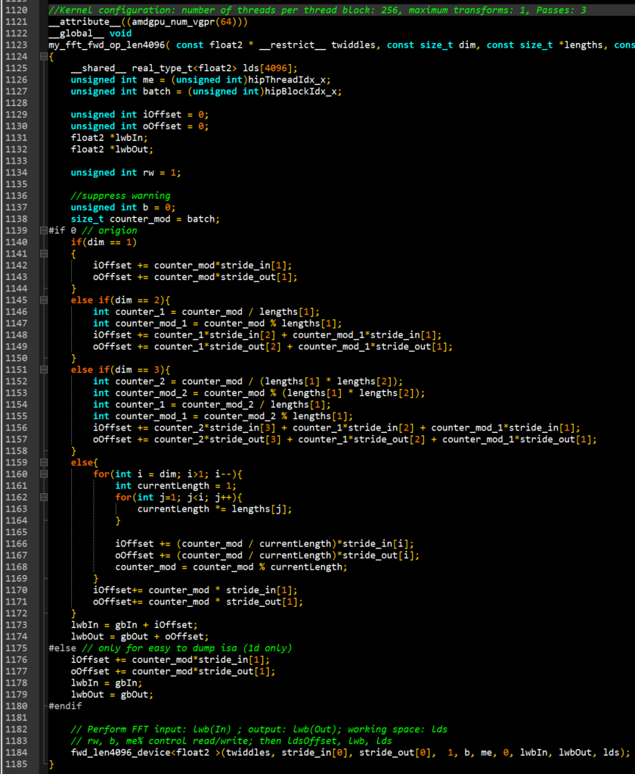
Weekly
Solution 2
Solution 2: compiler attribute
Use attribute for fft_op_kernel to limited vgpr usage
__attribute__((amdgpu_num_vgpr(64)))
Compiler could only use 64 vgprs at most.
How the compiler save the 4 vgprs???
NOT figure out yet (on going)
How to set the limit number???

Slide 10
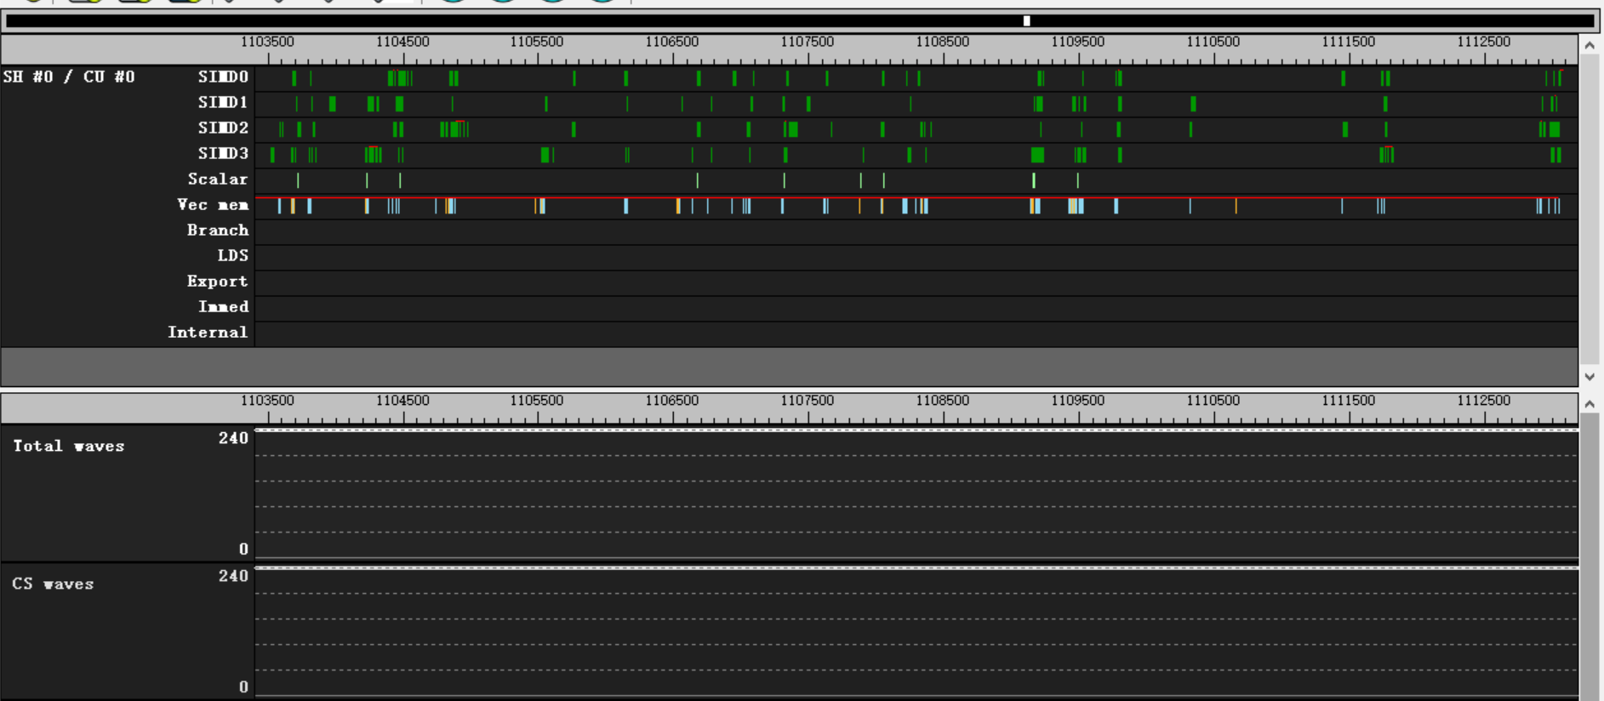
Weekly
Solution 2
Dangerous
If limit the vgpr to a not reasonable small number,
the compiler won’t have enough vgprs to do it’s work, it will use scratch buffer.
That will generate numbers of global memory read/write instructions
Cause sharply perf-drop
Amdgpu_vgpr_num(16)
Duration 0.033ms -> 0.35ms

Slide 11
Weekly
Solution 2
DANGEROUS
FFT: length = 3125, dim = 1d, c2c forward, batch size = 300, iteration = 1000
GPU: 60 CU
Workload: group size = 125(2 wave), group num = 300, LDS usage = 3125 DW (5 groups per CU at most)
Origin: VGPR = 120, parallel wave per SIMD = 2, parallel group per CU = 4, dispatch number = 2
Limit : VGPR = 84, parallel wave per SIMD = 3, parallel group per CU = 5, dispatch number = 1
Performance drop: duration from 0.064ms to 0.144ms

Slide 12
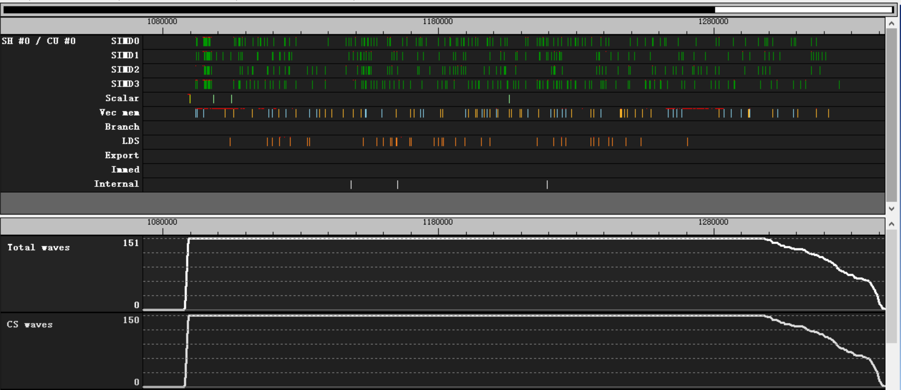
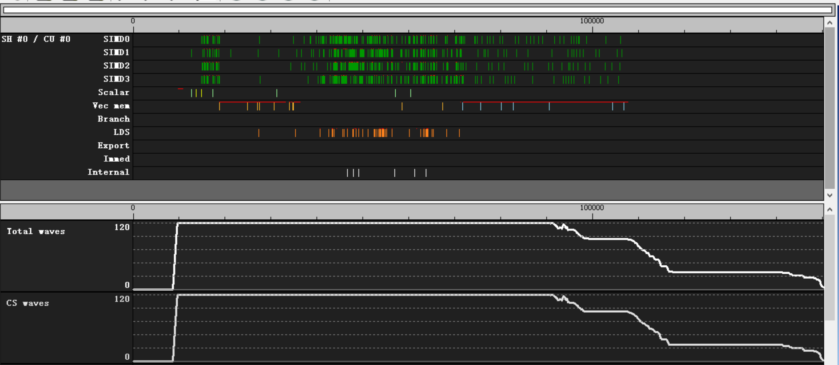
Weekly
Solution 2
DANGEROUS
FFT: length = 3125, dim = 1d, c2c forward, batch size = 300, iteration = 1000
84 VGPR
120 VGPR
second dispatch

Slide 13
Weekly
Solution 2
DANGEROUS
FFT: length = 3125, dim = 1d, c2c forward, batch size = 300, iteration = 1000
84 VGPR
scratch memory access
120 VGPR

Slide 14
Weekly
performance
Performance
FFT: length = 4096, dim = 1d, c2c forward, batch size = 240, iteration = 1000
GPU: 60CU
Workload: group size = 256(4wave), group num = 240, LDS usage = 4K DW
VGPR | Parallel wave / SIMD | Parallel group / CU | Dispatch times | Duration (ms)
52 | 4 | 4 | 1 | 0.032
64 | 4 | 4 | 1 | 0.033
68 | 3 | 3 | 2 | 0.035
for multi-batch, increase parallel wave/group number will reduce dispatch times
reduce vgpr usage will increase instruction number

Slide 15
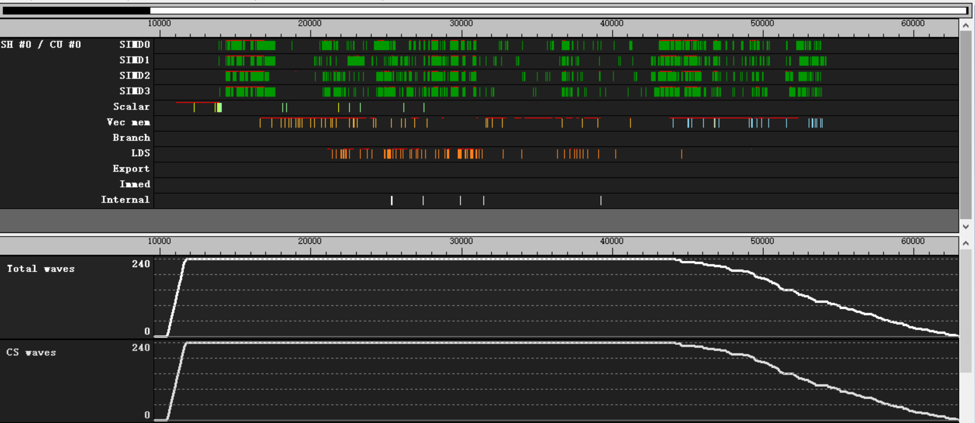
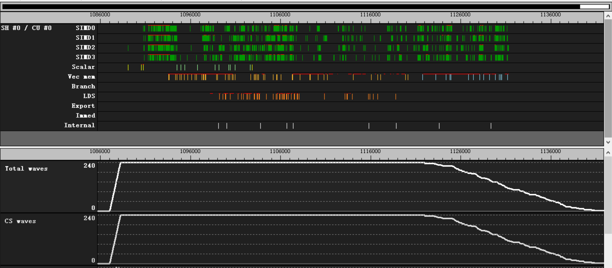
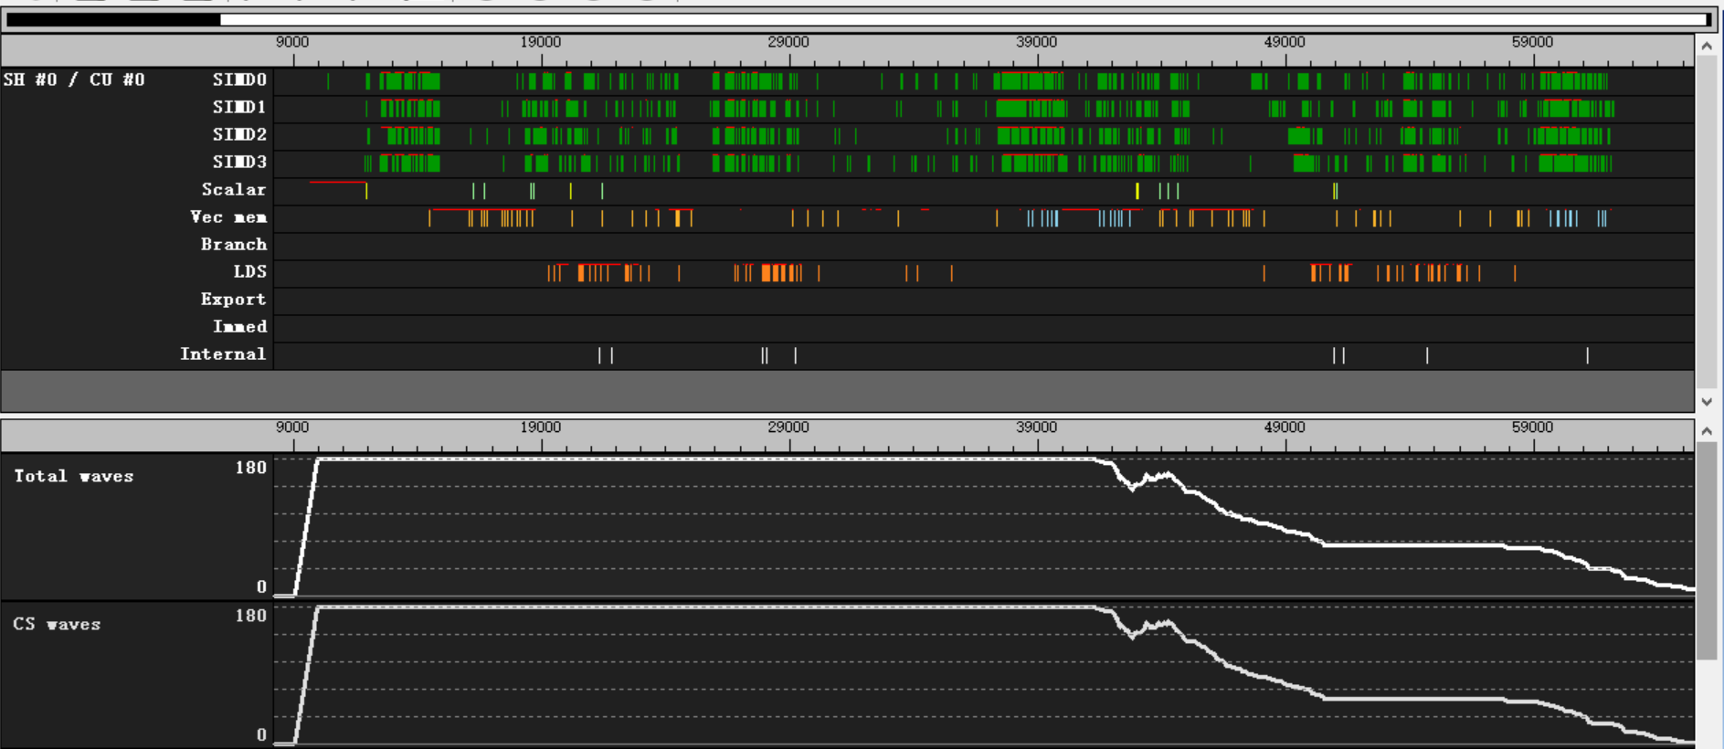
Weekly
performance
52 VGPR
64 VGPR
68 VGPR
second dispatch

Slide 16
Weekly
performance
52 VGPR
64 VGPR
68 VGPR
second dispatch

